Slide 1
Introduction to Concurrent Programming with GPUs
Coursera Lab and Assignment Overview

Slide 2
Coursera Lab Activity/Assignment Steps
Open Coursera Lab (VS Code)
Open module directory
Read module README.md text file for specific instructions
Edit .py, .cpp, .hpp, and other applicable code file
In terminal, use commands to clean, build, run one or more iterations of code
For assignments, edit .user and appropriate code variables (specified in README.md), and submit assignment

Slide 3
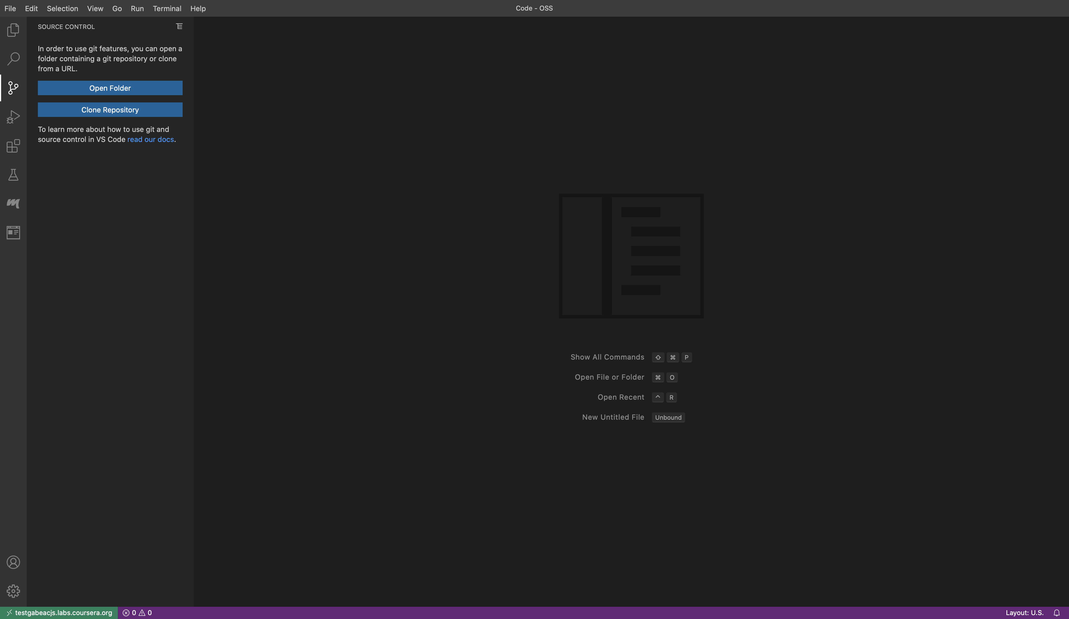
Coursera Lab - VS Code editor
1

Slide 4
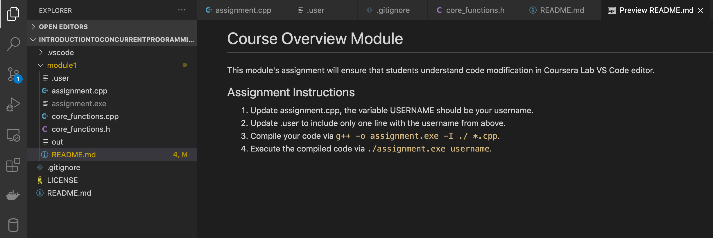
Open module directory and view README.md
2
3

Slide 5
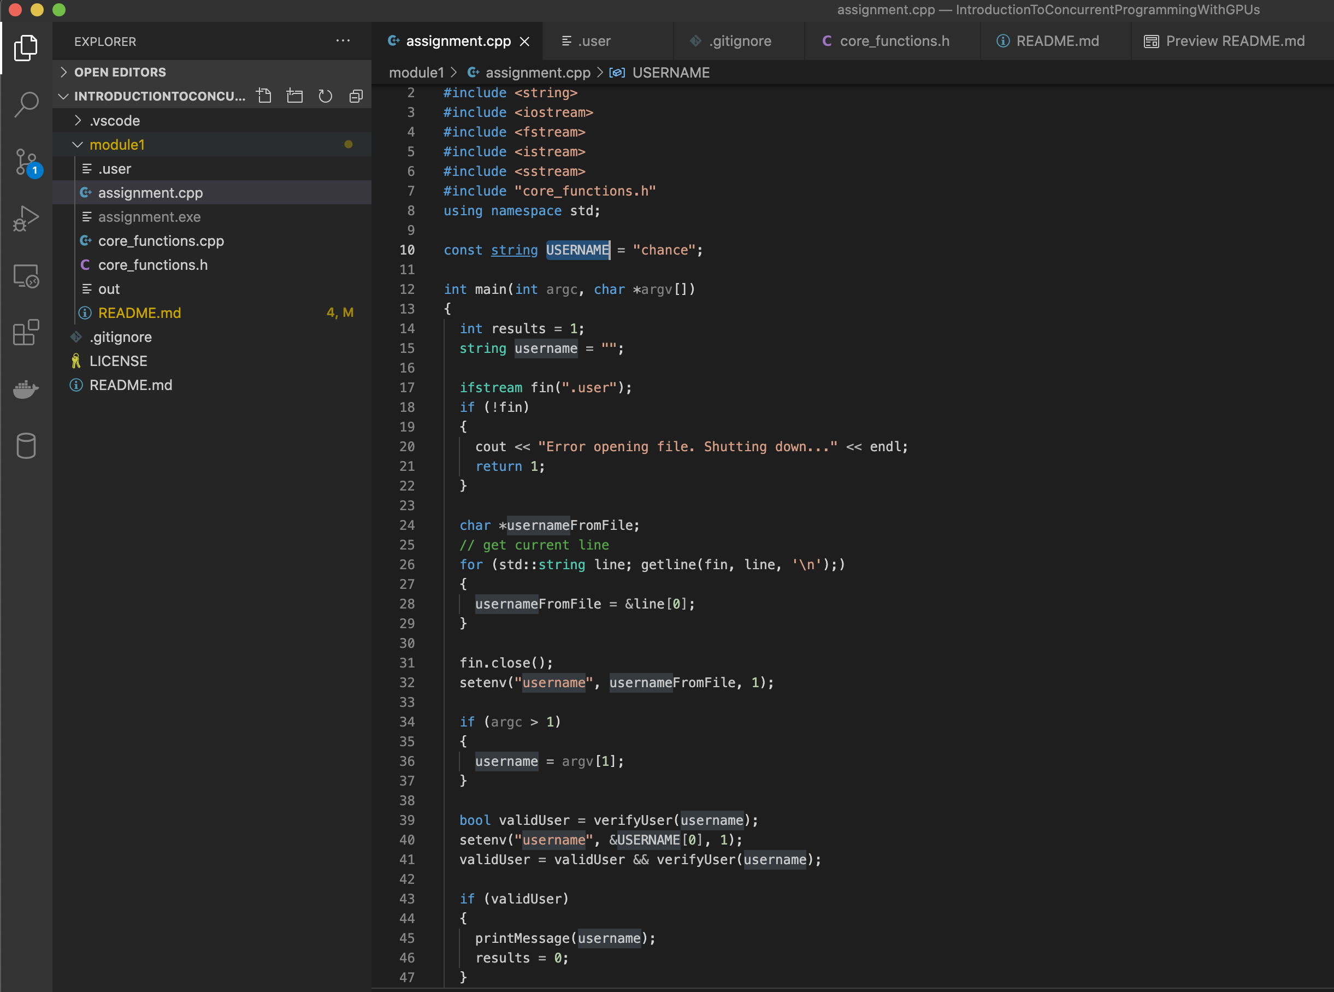
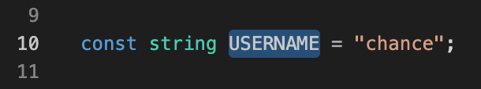
Edit Code Files (.py, .cpp, .h, .cu)
4

Slide 6
Cleaning, Building, and Running Code
5
make commands:
clean – clean all created files
build – compile all files into executable
run USERNAME – execute one iteration of code with USERNAME as argument
sh run.sh N USERNAME - executes N runs of code with argument of USERNAME

Slide 7
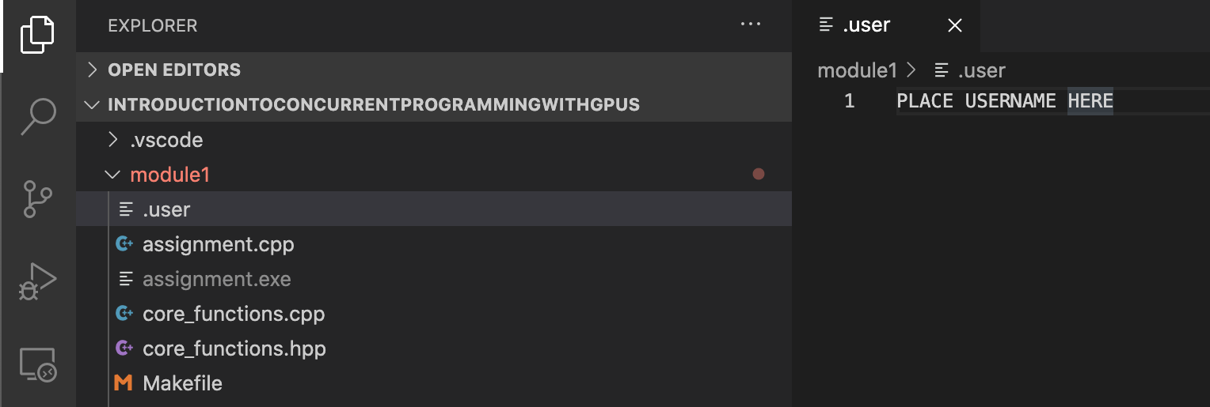
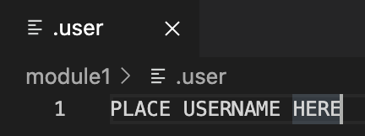
For Assignments update code and .user
6
7

